Slide 1


Credit for Prior Learning Posters
Developed by:

Slide 2
Using The CPL Posters
In the following pages, you’ll find a series of poster options promoting credit for prior learning (CPL) that you can customize for your campus and learners.
We encourage you to change the language to match your campus’ policies and programs related to CPL. On all posters, we have provided images and suggested language, but you can edit the language as you need.
PowerPoint Directions:
In the PowerPoint files, you can edit any of the languages on the page, but the images will all remain static. To edit the language, simply click on the text boxes and edit as you would with any PowerPoint. You can also change colors, font, and font sizes in the PowerPoint.
The posters use Bernoru and “Open Sans” fonts. Bernoru is part of the Microsoft Suite, and you can download and install Open Sans for free from Google. (Click here to download Open Sans from Google Fonts.) You can also substitute Open Sans with Arial and Bernoru with Arial Black as a font.
The images and backgrounds are saved as backgrounds on each of the posters and are not editable. For a fully editable file, you’ll need to download the Adobe Creative Suite files.
Suggested Printing Size
These posters were designed to be 18 in. x 24 in. posters when printed.
Thank you for sharing the opportunity of credit for prior learning with your campus and students!

Slide 3

EARN COLLEGE CREDIT FOR WHAT YOU ALREADY KNOW.
[Institution name] offers credit for prior learning, which gives you academic credit for skills and knowledge you already have.
Talk to us today to see if your knowledge and prior learning can be turned into credit to save you time and money toward your degree.
Call or text [name] at 888-555-5555. Or email [email@email.edu] to find out about your prior learning credit.

Slide 4


EARN COLLEGE CREDIT FOR WHAT YOU ALREADY KNOW.
[Institution name] offers credit for prior learning (CPL), which gives you academic credit for skills and knowledge you already have.
Talk to us today to see if your knowledge can be turned into credit to save you time and money toward your degree.
Call or text [name] at 888-555-5555. Or email [email@email.edu] to find out about your prior learning credit.

Slide 5

EARN COLLEGE CREDIT FOR WHAT YOU ALREADY KNOW.
[Institution name] offers credit for prior learning, which gives you college credit for skills and knowledge you already have.
Talk to us today to see if your knowledge and prior learning can be turned into credit to save you time and money toward your degree.
Call or text [name] at 888-555-5555. Or email [email@email.edu] to find out about your prior learning credit.

Slide 6
Personas

Slide 7

I am fluent in two languages, which earned me college credit toward my degree at [college].
[Institution name] offers credit for prior learning, which gives you college credit for skills and knowledge you already have.
Take the next step. See if you can save time and money toward your degree.
Call or text [name] at 888-555-5555. Or email [email@email.edu] to find out about your prior learning credit.
Save time and money with credit for prior learning.

Slide 8

I’m a pharmacy technician. I saved time and money by getting college credit for my on-the-job training.
[Institution name] offers credit for prior learning, which gives you college credit for skills and knowledge you already have.
Take the next step. See if you can save time and money toward your degree.
Call or text [name] at 888-555-5555. Or email [email@email.edu] to find out about your prior learning credit.
The road to your degree can be shorter than you think.

Slide 9

I am a certified EMT. I earned college credit for that knowledge so I can finish my degree faster.
[Institution name] offers credit for prior learning, which gives you college credit for skills and knowledge you already have.
Take the next step. See if you can save time and money toward your degree.
Call or text [name] at 888-555-5555. Or email [email@email.edu] to find out about your prior learning credit.
The road to your degree can be shorter than you think.

Slide 10

I owned my own business for 10 years. [College] gave me college credit for my knowledge.
[Institution name] offers credit for prior learning, which gives you college credit for skills and knowledge you already have.
Take the next step. See if you can save time and money toward your degree.
Call or text [name] at 888-555-5555. Or email [email@email.edu] to find out about your prior learning credit.
Save time and money with credit for prior learning.

Slide 11
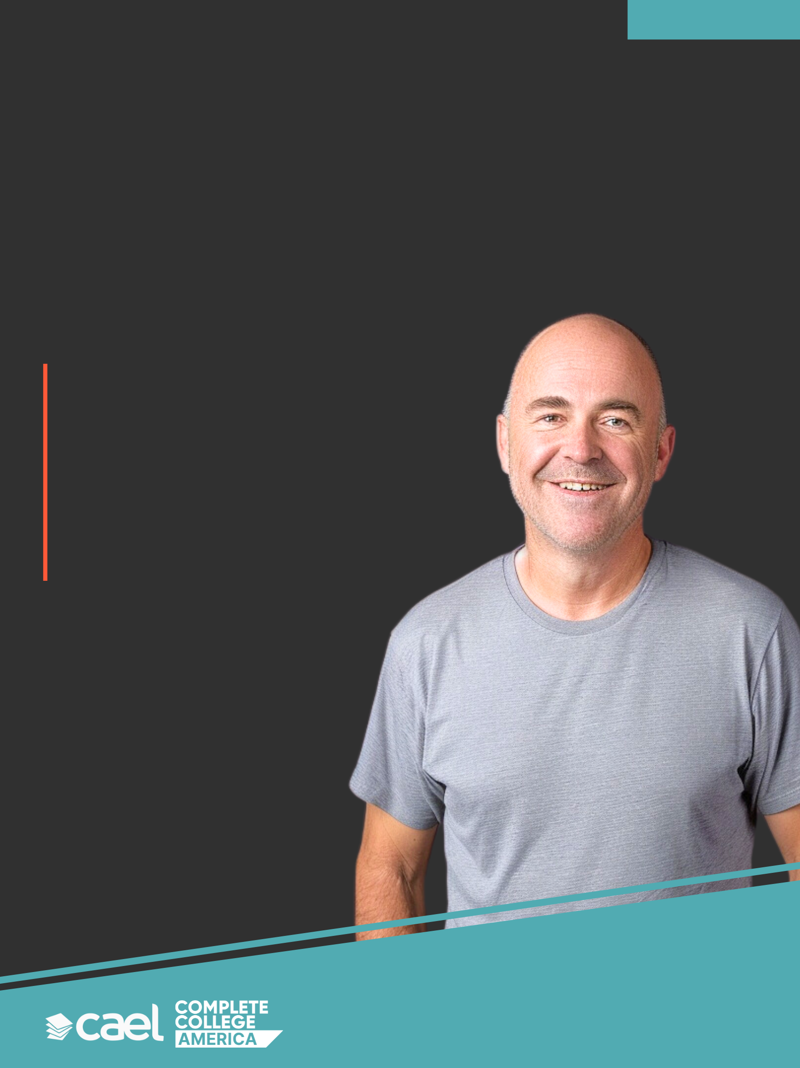
I’m a veteran. My time in the military earned me college credit at [institution name].
[Institution name] offers credit for prior learning, which gives you college credit for skills and knowledge you already have.
Take the next step. See if you can save time and money toward your degree.
Call or text [name] at 888-555-5555. Or email [email@email.edu] to find out about your prior learning credit.
The road to your degree can be shorter than you think.

Slide 12

I have a digital marketing certificate. [Institution name] awarded me college credit for that certificate.
[Institution name] offers credit for prior learning, which gives you college credit for skills and knowledge you already have.
Take the next step. See if you can save time and money toward your degree.
Call or text [name] at 888-555-5555. Or email [email@email.edu] to find out about your prior learning credit.
The road to your degree can be shorter than you think.

Slide 13

I have a digital marketing certificate. [Institution name] awarded me college credit for that certificate.
[Institution name] offers credit for prior learning, which gives you college credit for skills and knowledge you already have.
Take the next step. See if you can save time and money toward your degree.
Call or text [name] at 888-555-5555. Or email [email@email.edu] to find out about your prior learning credit.
The road to your degree can be shorter than you think.

Slide 14
Color Variations

Slide 15

I have a digital marketing certificate. [Institution name] awarded me college credit for that certificate.
[Institution name] offers credit for prior learning, which gives you college credit for skills and knowledge you already have.
Take the next step. See if you can save time and money toward your degree.
Call or text [name] at 888-555-5555. Or email [email@email.edu] to find out about your prior learning credit.
The road to your degree can be shorter than you think.

Slide 16

I am a certified EMT. I earned college credit for my knowledge so I can finish my degree faster.
[Institution name] offers credit for prior learning, which gives you college credit for skills and knowledge you already have.
Take the next step. See if you can save time and money toward your degree.
Call or text [name] at 888-555-5555. Or email [email@email.edu] to find out about your prior learning credit.
The road to your degree can be shorter than you think.

Slide 17

I owned my own business for 10 years. [College] gave me college credit for my knowledge.
[Institution name] offers credit for prior learning, which gives you college credit for skills and knowledge you already have.
Take the next step. See if you can save time and money toward your degree.
Call or text [name] at 888-555-5555. Or email [email@email.edu] to find out about your prior learning credit.
Save time and money with credit for prior learning.

Slide 18
Copy Variations

Slide 19
I have a digital marketing certificate. [Institution name] awarded me college credit for that certificate.
[Institution name] offers credit for prior learning, which gives you college credit for skills and knowledge you already have.
Find out if you can save time and money with CPL — credit for prior learning.
Call or text [name] at 888-555-5555. Or email [email@email.edu] to find out about your prior learning credit.
The road to your degree can be shorter than you think.

Slide 20

I am fluent in two languages, which earned me college credit toward my degree at [college].
[Institution name] offers credit for prior learning, which gives you college credit for skills and knowledge you already have.
The world is your classroom. Earn college credit for your knowledge with credit for prior learning.
Call or text [name] at 888-555-5555. Or email [email@email.edu] to find out about your prior learning credit.
Save time and money with credit for prior learning.

Slide 21

I am fluent in two languages, which earned me college credit toward my degree at [college].
[Institution name] offers credit for prior learning, which gives you college credit for skills and knowledge you already have.
The world is your classroom. Earn college credit for your work & life experiences with credit for prior learning.
Call or text [name] at 888-555-5555. Or email [email@email.edu] to find out about your prior learning credit.
Save time and money with credit for prior learning.

Slide 22

I am fluent in two languages, which earned me college credit toward my degree at [college].
[Institution name] offers credit for prior learning, which gives you college credit for skills and knowledge you already have.
The world is your classroom. Earn college credit for your work & life experiences with credit for prior learning.
Call or text [name] at 888-555-5555. Or email [email@email.edu] to find out about your prior learning credit.
Save time and money with credit for prior learning.

Slide 23

I’m a pharmacy technician. I saved time and money by getting college credit for my on-the-job training.
[Institution name] offers credit for prior learning, which gives you college credit for skills and knowledge you already have.
You can earn college credit based on work you‘ve already done. Find out if credit for prior learning is an option for you.
Call or text [name] at 888-555-5555. Or email [email@email.edu] to find out about your prior learning credit.
The road to your degree can be shorter than you think.

Slide 24

I’m a pharmacy technician. I saved time and money by getting college credit for my on-the-job training.
[Institution name] offers credit for prior learning, which gives you college credit for skills and knowledge you already have.
You can earn college credit based on work you‘ve already done. Find out if credit for prior learning is an option for you.
Call or text [name] at 888-555-5555. Or email [email@email.edu] to find out about your prior learning credit.
The road to your degree can be shorter than you think.

Slide 25

I am a certified EMT. I earned college credit for that knowledge so I can finish my degree faster.
[Institution name] offers credit for prior learning, which gives you college credit for skills and knowledge you already have.
Save time and money completing your degree through credit for prior learning.
Call or text [name] at 888-555-5555. Or email [email@email.edu] to find out about your prior learning credit.
The road to your degree can be shorter than you think.

Slide 26

I am a certified EMT. I earned college credit for that knowledge so I can finish my degree faster.
[Institution name] offers credit for prior learning, which gives you college credit for skills and knowledge you already have.
Save time and money completing your degree through credit for prior learning.
Call or text [name] at 888-555-5555. Or email [email@email.edu] to find out about your prior learning credit.
The road to your degree can be shorter than you think.

Slide 27

I owned my own business for 10 years. [College] gave me college credit for my knowledge.
[Institution name] offers credit for prior learning, which gives you college credit for skills and knowledge you already have.
Can your knowledge earn you college credit? Let’s find out together.
Call or text [name] at 888-555-5555. Or email [email@email.edu] to find out about your prior learning credit.
Save time and money with credit for prior learning.

Slide 28
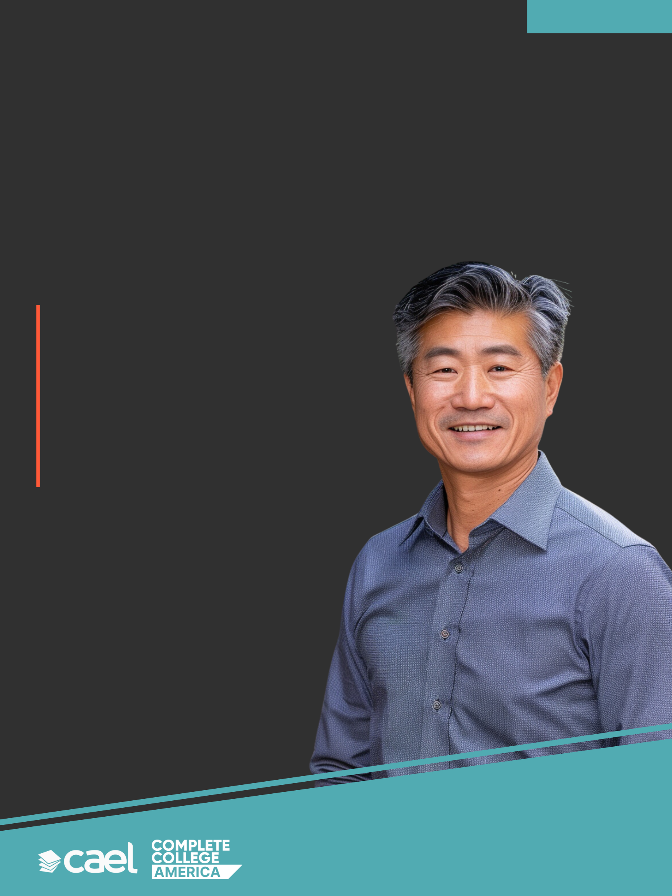
I owned my own business for 10 years. [College] gave me college credit for my knowledge.
[Institution name] offers credit for prior learning, which gives you college credit for skills and knowledge you already have.
Can your knowledge earn you college credit? Let’s find out together.
Call or text [name] at 888-555-5555. Or email [email@email.edu] to find out about your prior learning credit.
Save time and money with credit for prior learning.

Slide 29

I owned my own business for 10 years. [College] gave me college credit for my knowledge.
[Institution name] offers credit for prior learning, which gives you college credit for skills and knowledge you already have.
Can your knowledge earn you college credit? Let’s find out together.
Call or text [name] at 888-555-5555. Or email [email@email.edu] to find out about your prior learning credit.
Save time and money with credit for prior learning.

Slide 30

I’m a veteran. My time in the military earned me college credit at [institution name].
[Institution name] offers credit for prior learning, which gives you college credit for skills and knowledge you already have.
Learn how credit for prior learning can help you earn college credit for your knowledge.
Call or text [name] at 888-555-5555. Or email [email@email.edu] to find out about your prior learning credit.
The road to your degree can be shorter than you think.

